Slide 1


Library Management Systems
Directed by : Dr\ Yasmein Abdelmohsen
Made by :Afnan Mohamed

Slide 2
Library Systems
My project is a simple online library systems.
It contain : Admin user and Student user.
To complete this project I used HTML , CSS , ajax , jQuery, JavaScript, php and mysql.

Slide 3
Admin User Features
Admin dashboard
Admin can add/update/ delete category
Admin can add/update/ delete author
Admin can add/update/ delete books
Admin can issue a new book to student and also update the details when student return book
Admin can search student by using their student ID
Admin can also view student details
Admin can change own password
Admin enter : admin -- admin

Slide 4
Student User Features
Student can register yourself and after registration they will get studentid
After login student can view own dashboard.
Student can update own profile.
Student can view issued book and book return date-time.
Student can also change own password.
Student can also recover own password.
Student enter: afnan.am95@gmail.Com – 12345
Student enter: test@gmail.Com – Test@123

Slide 5
Data Base

Slide 6
Data Base
Data base tables:
Admin table
Authors table
Category table
Issu book details table
Book table
Student table

Slide 7
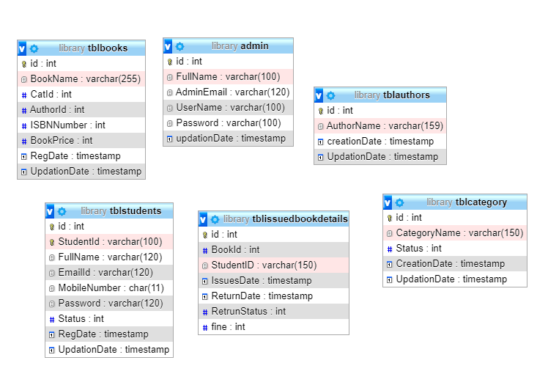
ERD Diagram

Slide 8
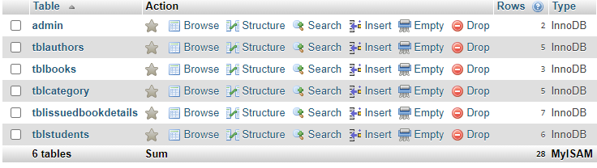
Data Base Tables

Slide 9
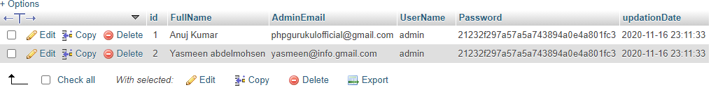
Admin Table

Slide 10
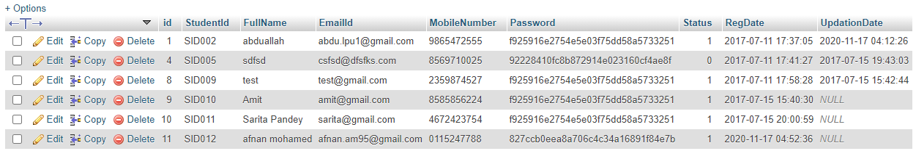
Student Table

Slide 11
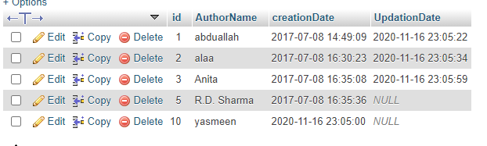
Authors Table

Slide 12
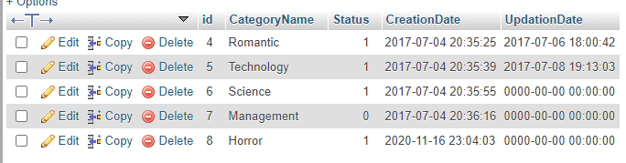
Category Table

Slide 13
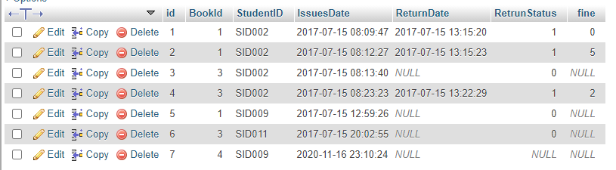
Issued Book Details Table

Slide 14
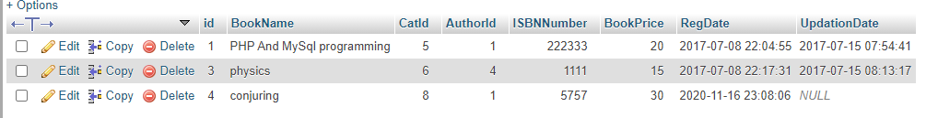
Book Table

Slide 15
Website

Slide 16
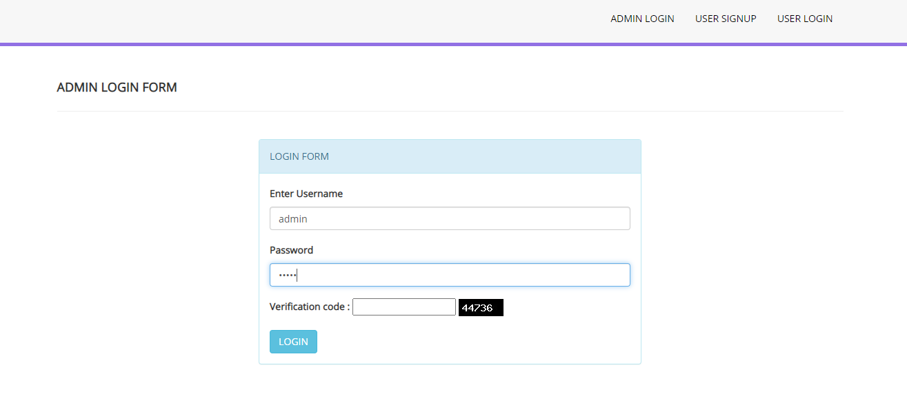
Admin Login Page

Slide 17
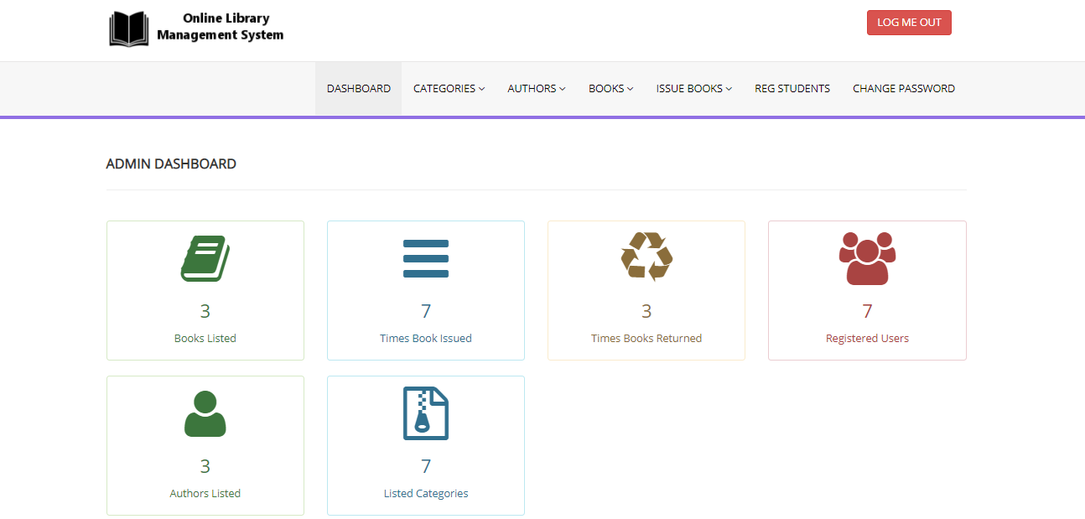
Admin Page

Slide 18
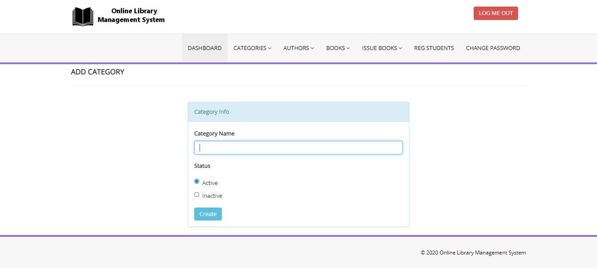
Admin-Add Category Page

Slide 19
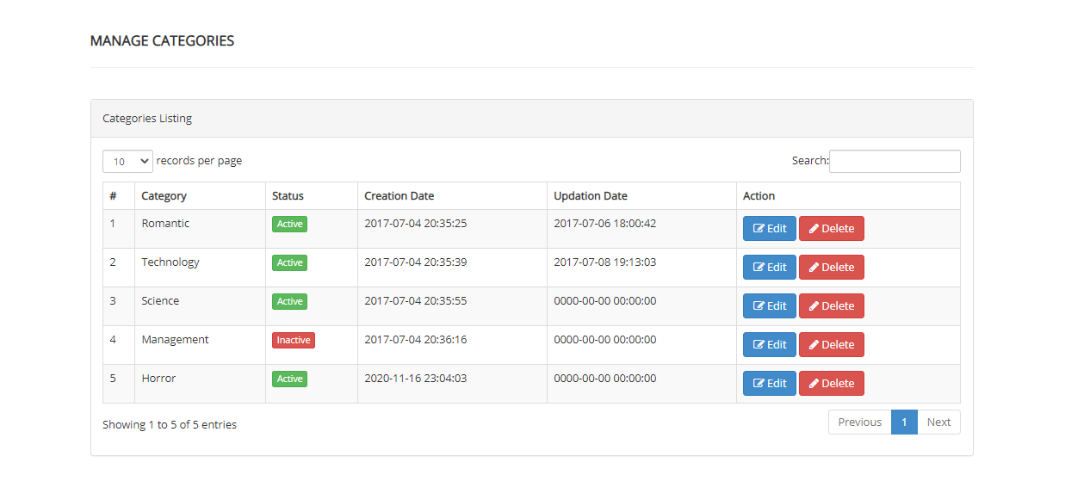
Admin-Manage Category Page

Slide 20
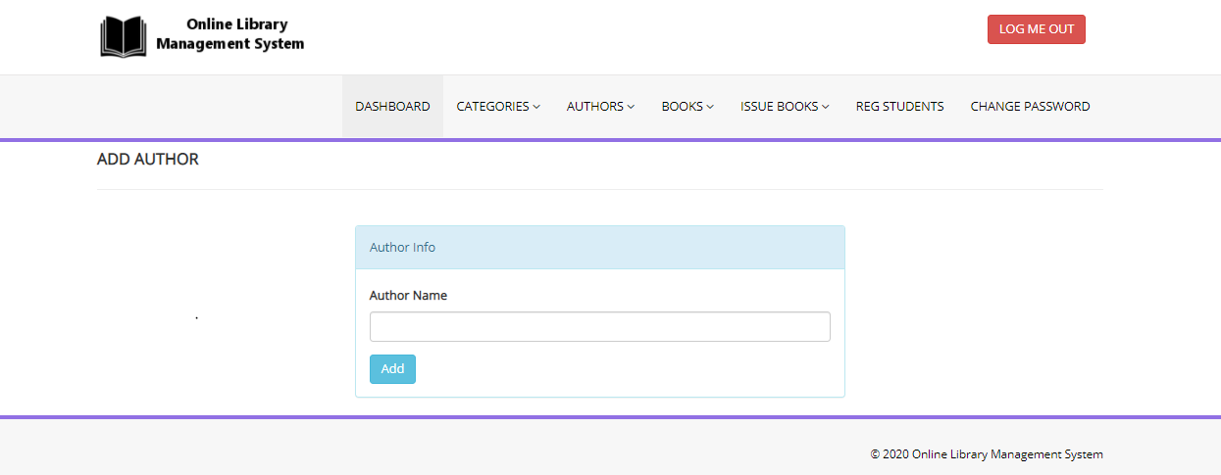
Admin-Add Author Page

Slide 21
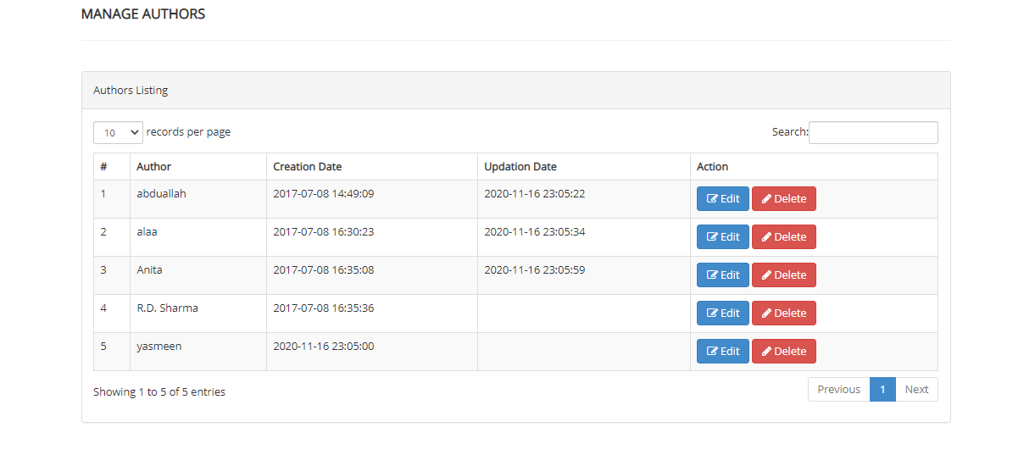
Admin-Manage Author Page

Slide 22
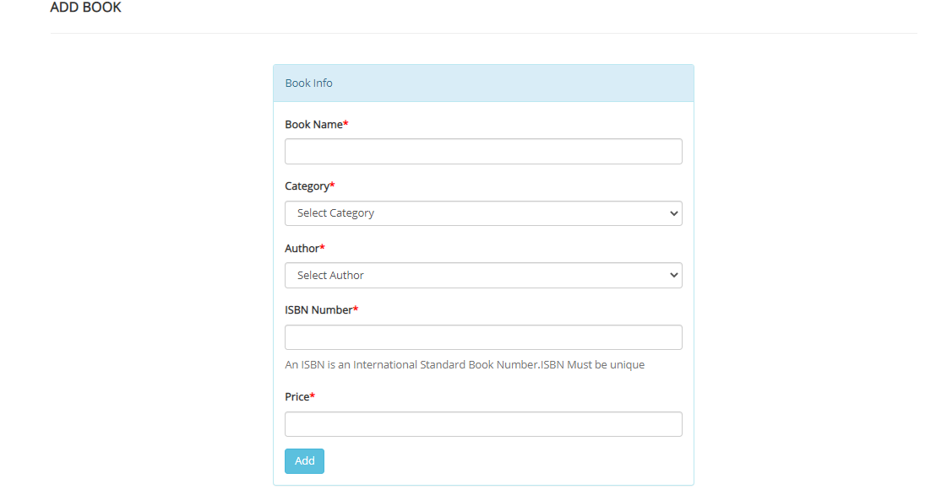
Admin-Add Books Page

Slide 23
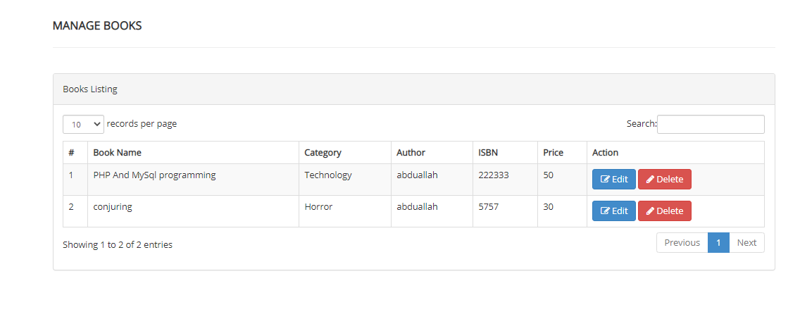
Admin-Manage Books Page

Slide 24
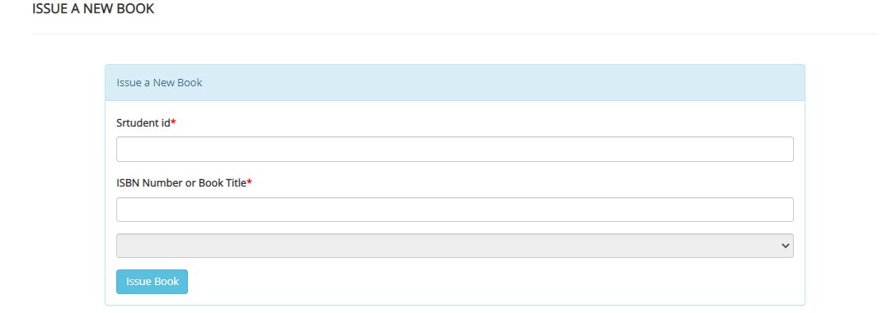
Admin-Add Issue Book Page

Slide 25
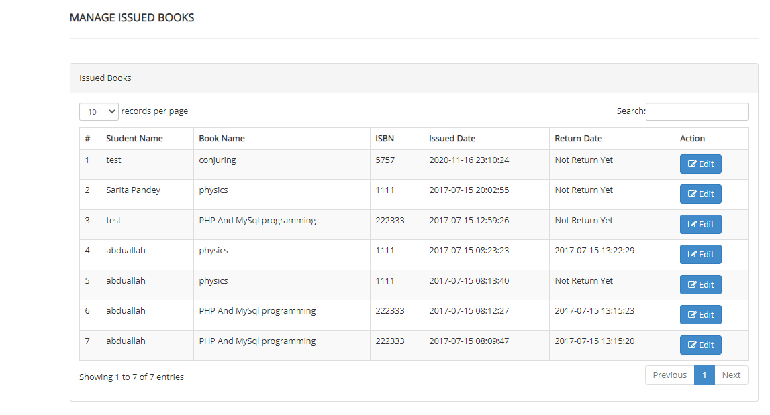
Admin-Manage Issue Book Page

Slide 26
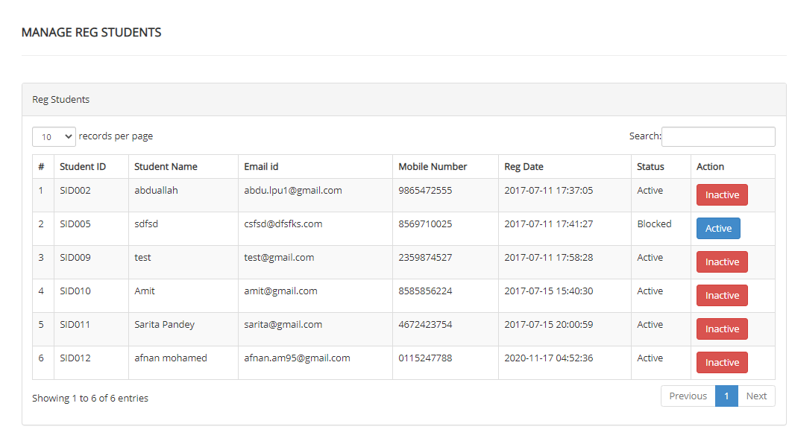
Admin-Manage Reg Student Page

Slide 27
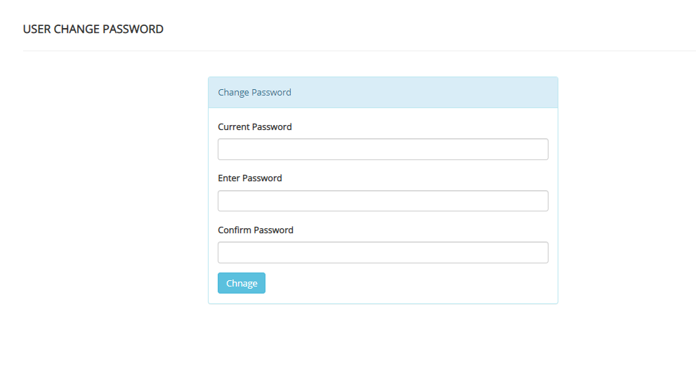
Admin-Change Password

Slide 28
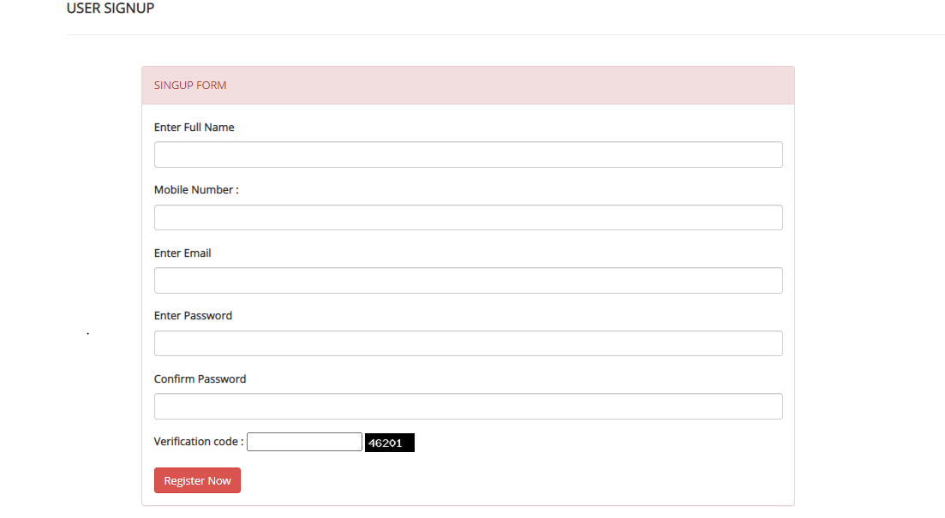
Student Sign up Page

Slide 29
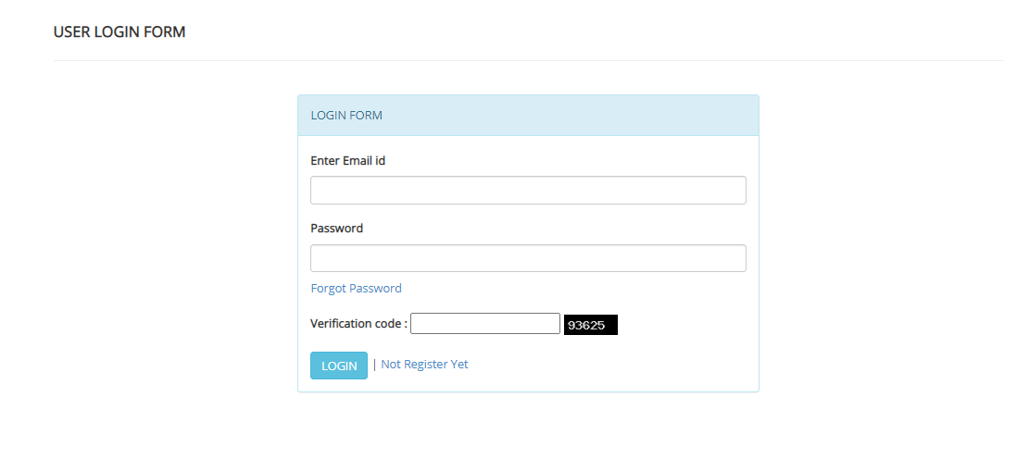
Student Login Page

Slide 30
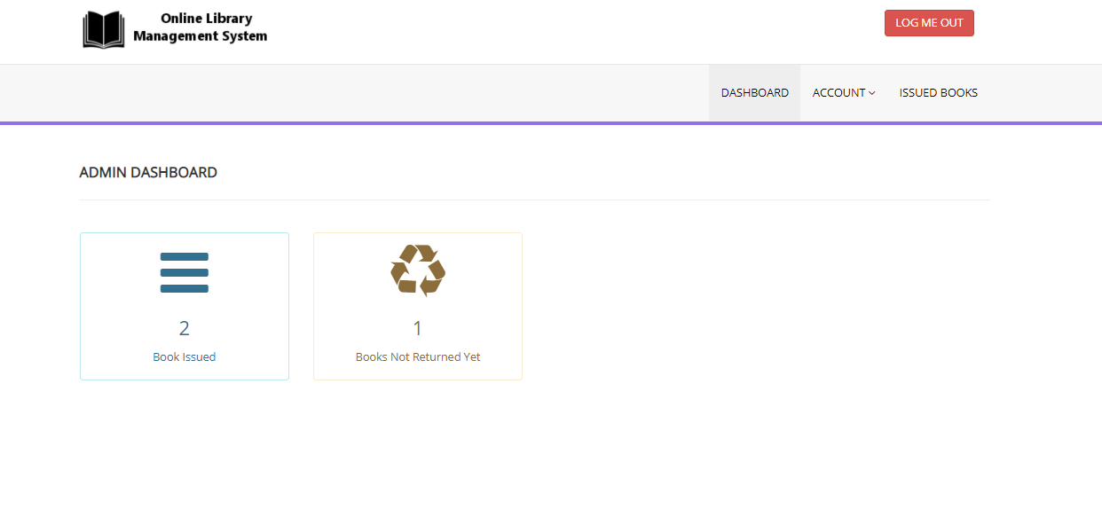
Student Page

Slide 31
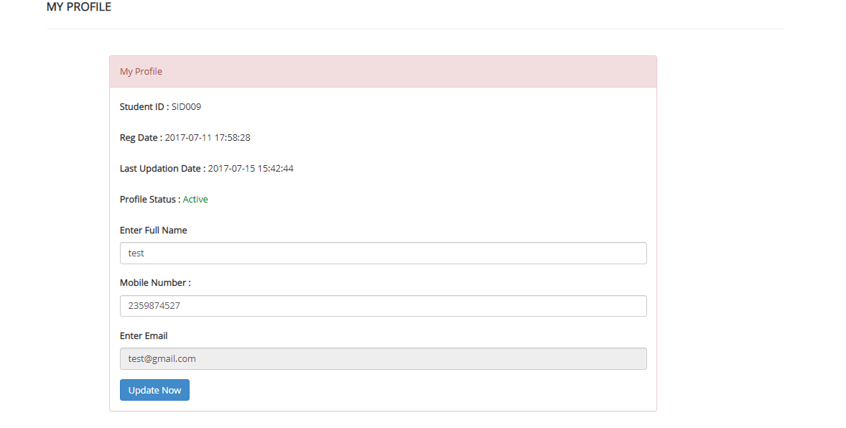
Student-Update Profile Page

Slide 32
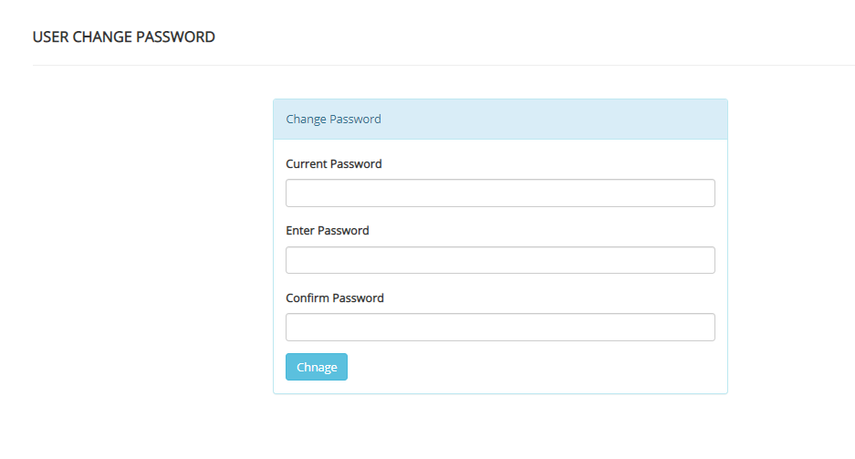
Student-Change Password Page

Slide 33
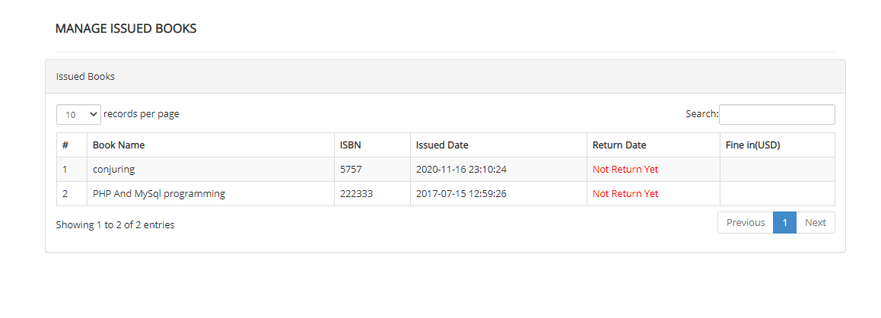
Student-Manage Issued Book Page

Slide 34
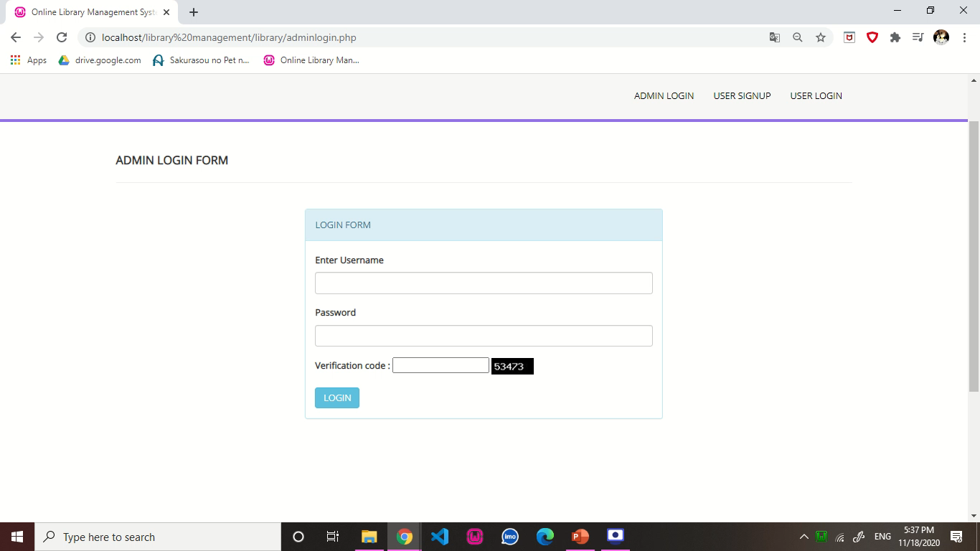
Video For Website

Slide 35
Thanks For Yat Center And Special Thanks For: Dr\ Yasmein Abdelmohsen

